Slide 1


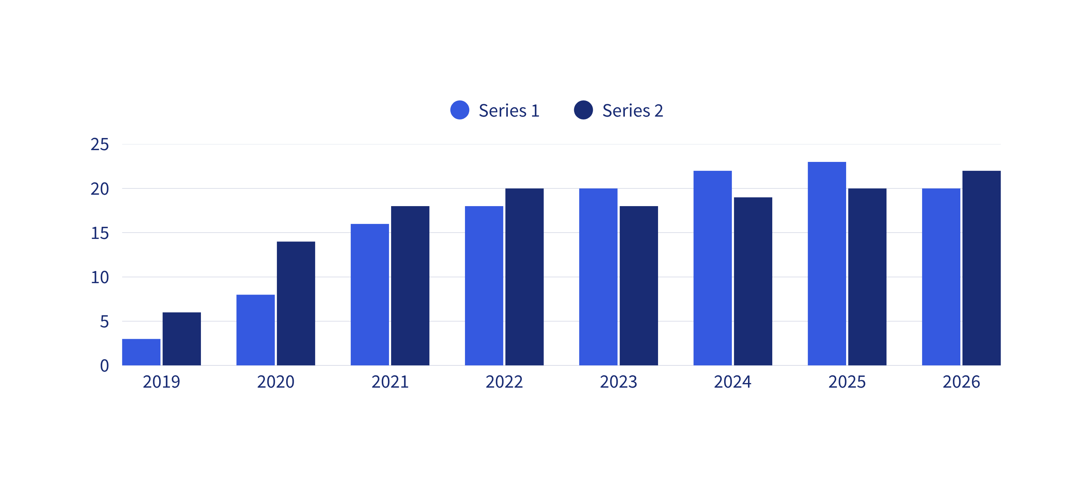


ACADEMIC RESEARCH
THE IMPACT OF SOCIAL MEDIA MARKETING ON CONSUMER BEHAVIOR
INTRODUCTION
Social media has become an integral part of modern marketing strategies, enabling brands to connect with consumers on a global scale. This paper explores the relationship between social media marketing and consumer behavior, investigating how different marketing techniques impact purchasing decisions and brand loyalty.
RESEARCH METHODOLOGY
QUANTITATIVE METHOD
QUALITATIVE METHOD
Online surveys conducted with 500 participants to measure consumer engagement and response to social media advertisements.
Interview with 20 marketing professionals and consumers to gain insights into perceptions and experiences related to social media marketing.
Social media campaigns significantly increase brand recognition.
User generated content and influencer marketing enhance consumer trust.
Personalized ads and interactive content influence buying behavior.
CONCLUSION
Social media marketing is a powerful tool for influencing consumer behavior. Businesses should focus on authenticity, personalization, and engagement to maximize marketing effectiveness. Future research could explore the impact of emerging platforms and technologies on consumer brand relationships.
REFERENCE
Hannah Morales
Bailey Dupont
Daniel Gallego
www.reallygreatsite.com
www.reallygreatsite.com
www.reallygreatsite.com

